Slide 1
Coursera Capstone IBM Applied Data Science Capstone Opening A New Shopping Mall In Hyderabad, Telangana
By: Sai Venkatesh
July 2019

Slide 2
Contents
Introduction
Business Problem
Target audience of project
Data ( Source and methods of extraction )
Methodology
Results
Discussion
Conclusion
References

Slide 3
Business Problem
Location of the shopping mall is one of the most important decisions that will determine whether the mall will be a success or a failure
Objective : To analyse and select the best locations in the city of Hyderabad, Telangana to open a new shopping mall
Business question
In the city of Hyderabad, Telangana, if a property developer is looking to open a new shopping mall, where would you recommend that they open it?

Slide 4
Data
Data required
List of neighbourhoods in Hyderabad
Latitude and longitude coordinates of the neighbourhoods
Venue data, particularly data related to shopping malls
Sources of data
Wikipedia page for neighbourhoods (https://en.wikipedia.org/wiki/Category:Neighbourhoods_in_Hyderabad,_India )
Geocoder package for latitude and longitude coordinates
Foursquare API for venue data

Slide 5
Methodology
Web scraping Wikipedia page for neighbourhoods list
Get latitude and longitude coordinates using Geocoder
Use Foursquare API to get venue data
Group data by neighbourhood and taking the mean of the frequency of occurrence of each venue category
Filter venue category by ShoppingMall
Perform clustering on the data by using k-means clustering
Visualize the clusters in a map using Folium

Slide 6
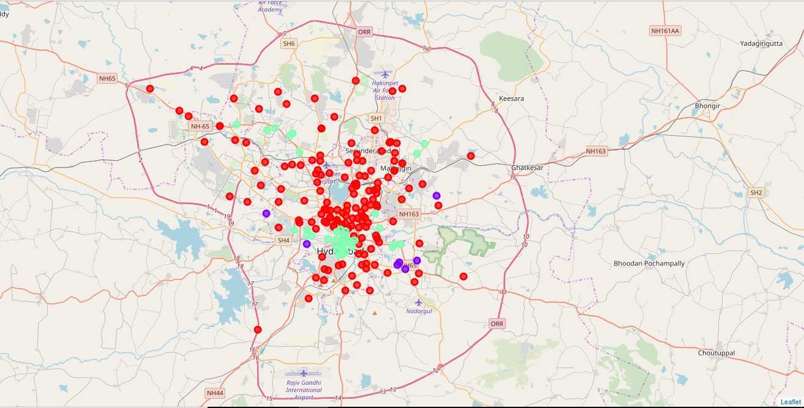
Results
The results from the k-means clustering show that we can categorize the neighbourhoods into 3 clusters based on the frequency of occurrence for “Shopping Mall”:
Cluster 0: Neighbourhoods with low number to no existence of shopping malls
Cluster 1: Neighbourhoods with high concentration of shopping malls
Cluster 2: Neighbourhoods with moderate number of shopping malls
* The results of the clustering are visualized in the map above with cluster 0 in red
colour, cluster 1 in purple colour, and cluster 2 in mint green colour

Slide 7
Discussion
Most of the shopping malls are concentrated in the central area of Hyderabad city.
The highest number in cluster 1 and moderate number in cluster 2.
On the other hand, cluster 0 has very low number to totally no shopping mall in the neighbourhoods.
Oversupply of shopping malls mostly happened in the central area of the city, with the suburb area still have very few shopping malls

Slide 8
Recommendations
Open new shopping malls in neighbourhoods in cluster 0 with little to no competition
Can also open in neighbourhoods in cluster 2 with moderate competition if have unique selling propositions to stand out from the competition
Avoid neighbourhoods in cluster 1, already high concentration of shopping malls and intense competition

Slide 9
Conclusion
Answer to business question: The neighbourhoods in cluster 0 are the most preferred locations to open a new shopping mall
Findings of this project will help the relevant stakeholders to capitalize on the opportunities on high potential locations while avoiding overcrowded areas in their decisions to open a new shopping mall

Slide 10
References
Neighbourhoods in Hyderabad. Wikipedia. Retrieved from
https://en.wikipedia.org/wiki/Category:Neighbourhoods_in_Hyderabad,_India
Foursquare Developers Documentation. Retrieved from
https://developer.foursquare.com/docs

Slide 11
Thank You

